Slide 1


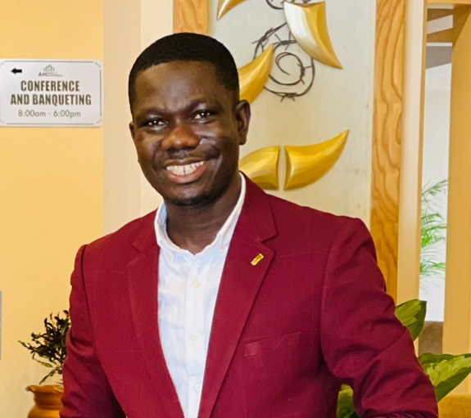
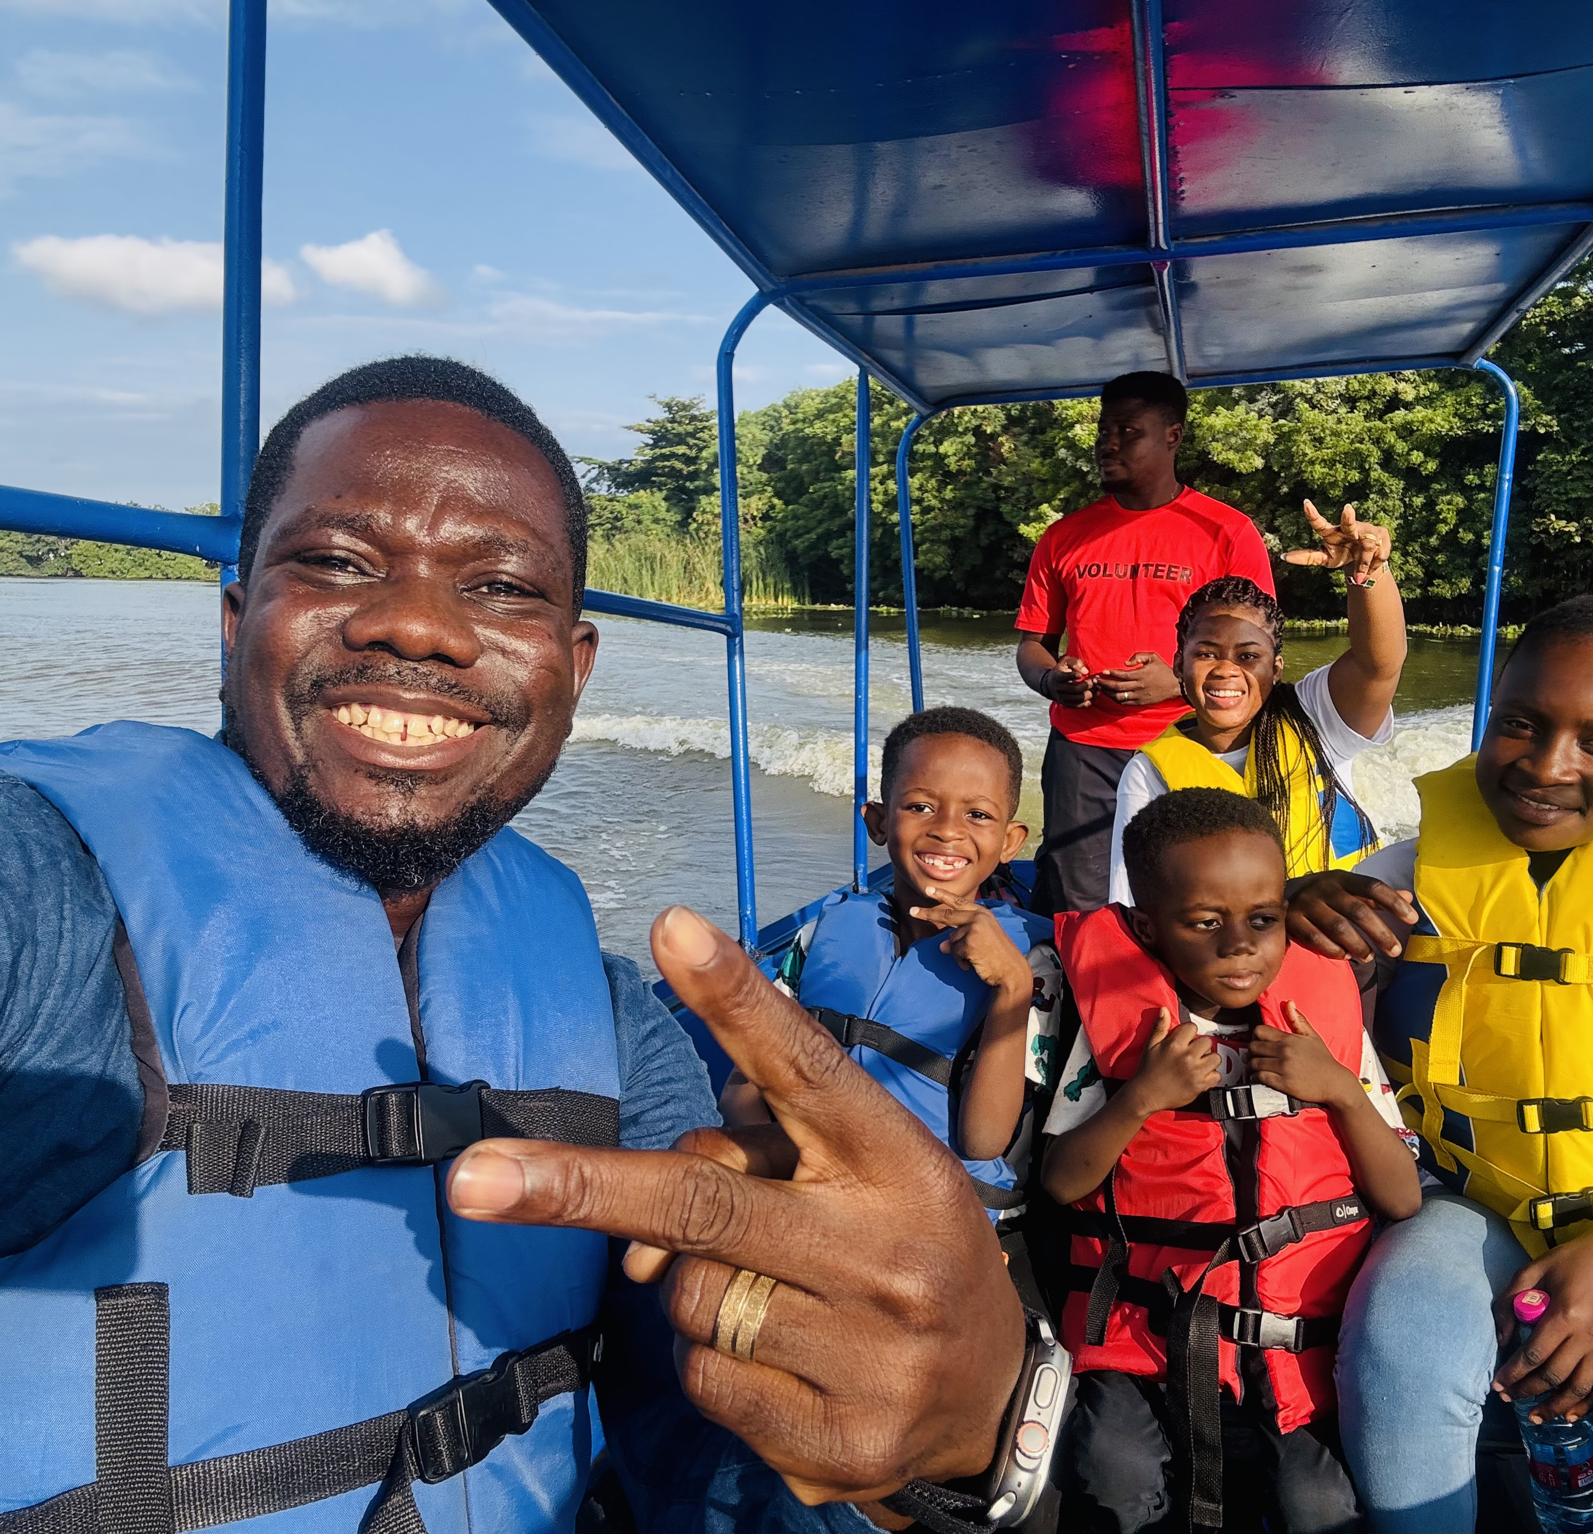
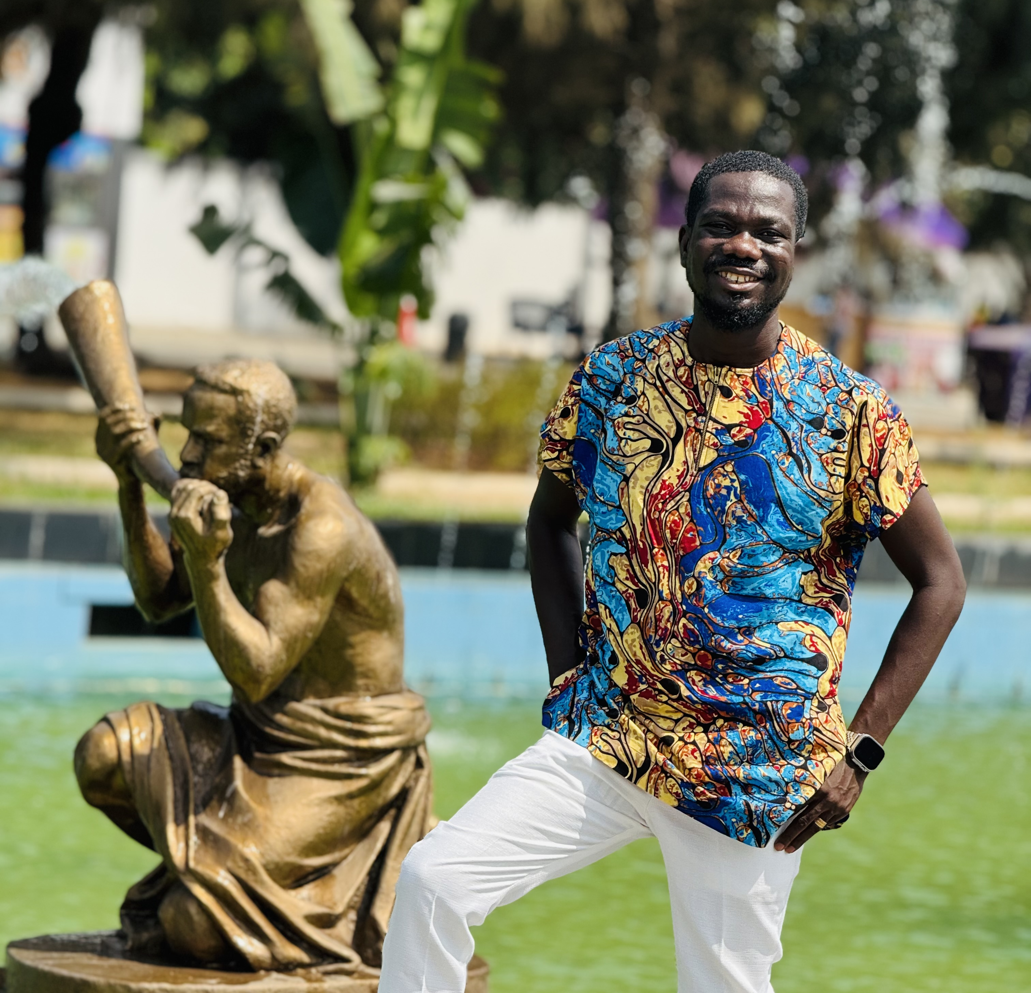
Getting to Know Me
Work
Personal
My role
Deputy Procurement Coordinator
Significant others / family members / furry friends in my life
Kate, Ivan, Myles, Bismark and German shepherd dogs.
Tenure in ofi/Olam
11 years
How I enjoy spending my free time
Reading, Watching of Movies, Football & Sightseeing
Previous companies I have worked at
Ghana Statistical Service, Central Unique Financial Services & Joeman Company Ltd
My favorite / comfort food
Fufu&Catfish Soup
Why I joined ofi/Olam and what keeps me here?
ofi is purpose-driven. What keeps me here is the perfect blend of purpose, innovation and growth.
My favorite song
Every Praise by Hezekiah Walker
Isaac Donkor
‘Isaac’
I love food like it’s a personality trait — especially anything soupy.
This is me outside work, doing stuff I enjoy in my life …

